Slide 1



SMART INDIA HACKATHON 2026
TITLE PAGE
Problem Statement ID – 6
Problem Statement Title- The rapid growth of interconnected systems has increased the complexity of cyber threats, unauthorised access, data breaches, identity related risks and manipulation of digital information. At the same time, organisations increasingly need to establish trust when exchanging information across different systems and stakeholders. There is a need for robust and intelligent solutions that can identify, prevent, respond to or reduce cybersecurity risks while improving trust and security in digital ecosystems.
Theme- Blockchain & Cybersecurity
PS Category- Hardware
Team ID- SIH26-T13

Slide 2

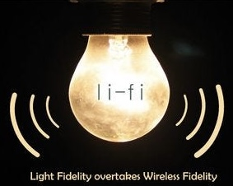
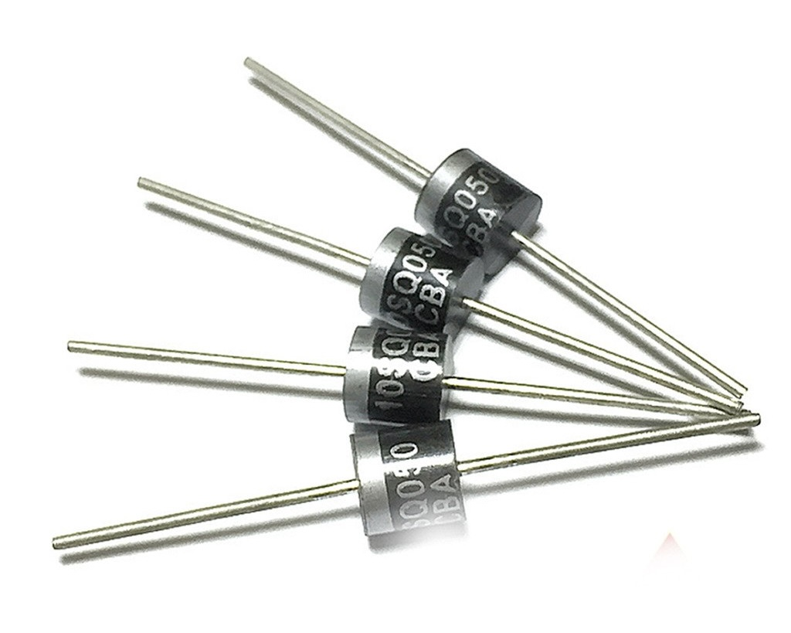
QUADSHIELD
Your Team Name
Proposed Solution
4-layered cybersecurity architecture.
Using Schottky diode alongside LiFi.
What it offers:
Stops voltage glitch attacks.
Enforces one way data transfer.
LiFi restricts data within the room.
@SIH Idea submission- Template

Slide 3
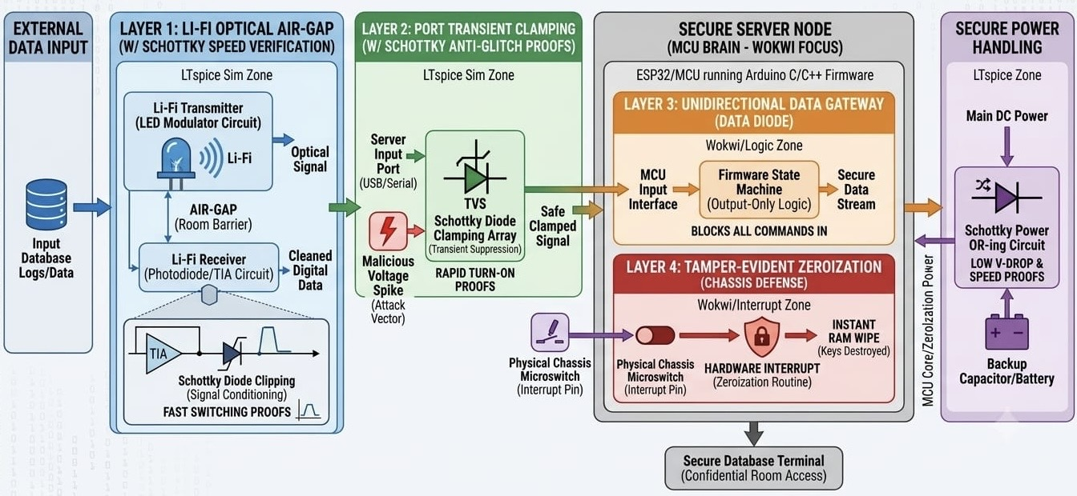
TECHNICAL APPROACH
Your Team Name
@SIH Idea submission- Template

Slide 4
FEASIBILITY AND VIABILITY
Your Team Name
Low-cost equipments are integrated.
Less complexity verified via simulations.
Layer 3 physically prevents inbound network traffic.
Strategy :
Including specialised unidirectional transport protocols (like SLDP) for outbound log transmission to blockchain node.
@SIH Idea submission- Template

Slide 5

IMPACT AND BENEFITS
Your Team Name
Potential impact it will have is drastic reduction of reliance on complex software patch cycles for port-level vulnerabilities.
The solution offers a air-gapped security mechanism for confidential facilities like DRDO.
@SIH Idea submission- Template

Slide 6
RESEARCH AND REFERENCES
Your Team Name
(2023). Performance analysis of an outdoor Li-Fi system-based AO-OFDM architecture under different FSO turbulence and weather conditions. Optik 273.
https://doi.org/10.1016/j.ijleo.2022.170427
AI Tools used- Gemini
Simulation Tools-
LTSpice
falstad.com
VN Editor
@SIH Idea submission- Template

